Slide 1
SAR Coherence Change Detection for damage assessment
Introduction

Slide 2
Coherence Change Detection principle
Coherent Change Detection, also known as CCD, is an intelligence gathering process in which two time-lapsed high-resolution satellite radar images of one geographic area on the surface of Earth, or other planets, are compared in order to detect and measure changes to that area.
Changes included into the coherence measurement can be considered as:
Geometric changes: changes due to slighly different incident angle
Changes occurred between the two SAR acquisitions involved in the computation
Noise: noise signal or noise introduced by the different processes.
Such comparisons are done using an algorithm that takes into account both the geographic area and mission parameters. The satellite-based imaging technology used most often to execute this process is known as Synthetic Aperture Radar, or SAR, which has led to CCD also often being called SAR Coherent Change Detection. Although radar-based intelligence gathering is a Measurement and Signals Intelligence (MASINT) category, the use of CCD products can be paired with Geospatial Intelligence (GEOINT) to visually depict physical features on the Earth.
A good example is found in this article which applies this principle, titled "Coherence Change-Detection with Sentinel-1 for Natural and Anthropogenic Disaster Monitoring in Urban Areas" (https://doi.org/10.3390/rs10071026 )

Slide 3
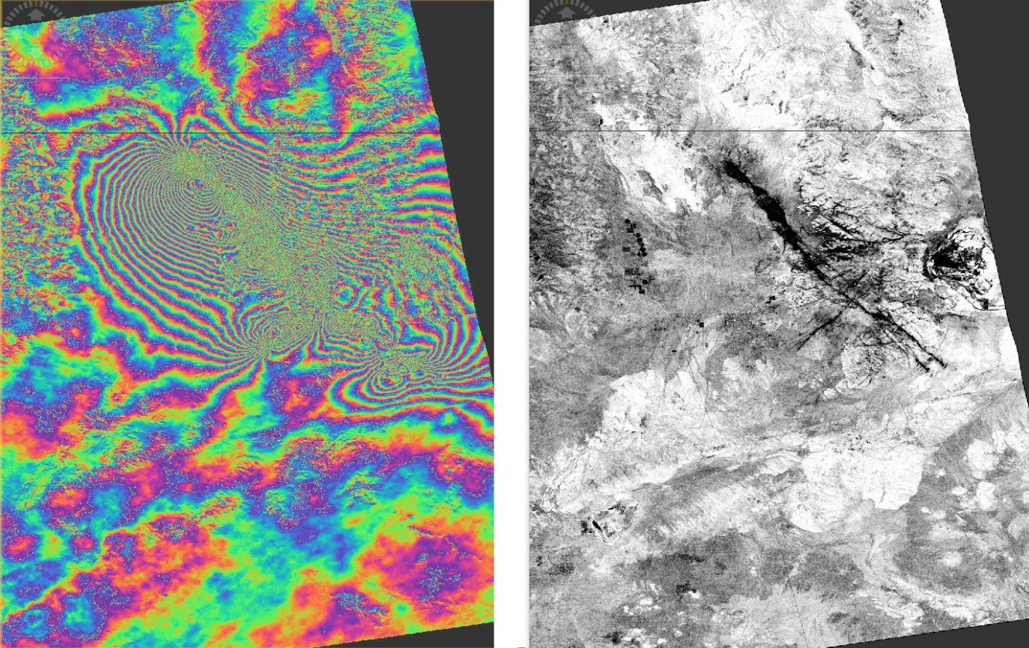
Coherence for Earthquake damage assessment
Interferogram showing colour fringes over affected extent (left)
Coherence map showing in black decorrelated areas with pre-post event SAR image pair
Contains modified Copernicus Sentinel-1 data [2019]

Slide 4
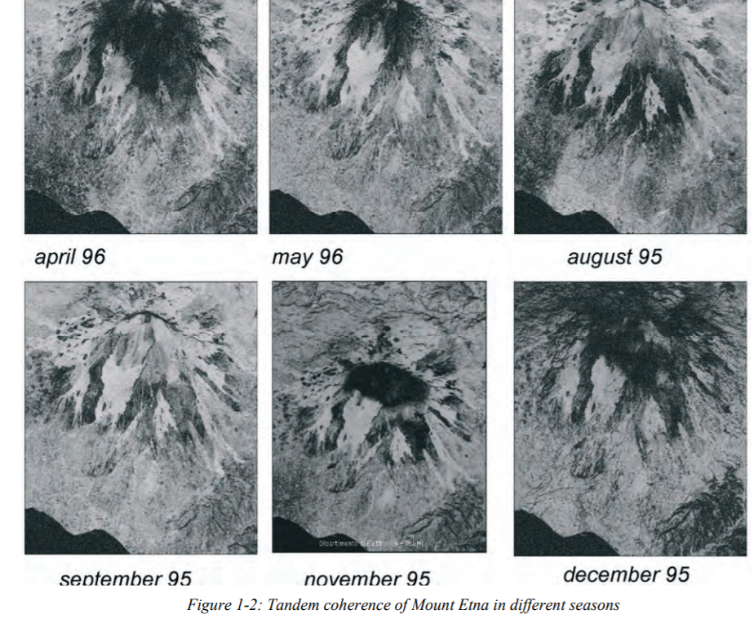
Time series coherence maps
Time series over Etna volcano using Tandem ERS dataset (source ESA: Part C InSAR processing: a mathematical approach)
Loose of correlation can be attributed to vegetation and snow coverage
This approach uses different SAR image pairs on each coherence generation, but same acquisition time difference

Slide 5
Coherence Change Detection
Considering one event, it can be computed 2 coherence maps, one pre- (two image acquired before the event) and one post-event (one image pre- and one image post). Reference image for both coherence maps should be the same, usually the nearest SAR image acquired before the event.
These images should belong to the same relative orbit, to ensure that images were acquires using same geometric characteristics. How we can identify/select the relative orbit of the SAR data? This is shown in next slides.
Areas where huge changes in coherence values appear can be attributed to changes occurred during the dates of the post-event coherence map.
Examples:
Beirut harbour blast on August 2020
Bata explosion on March 2021

Slide 6
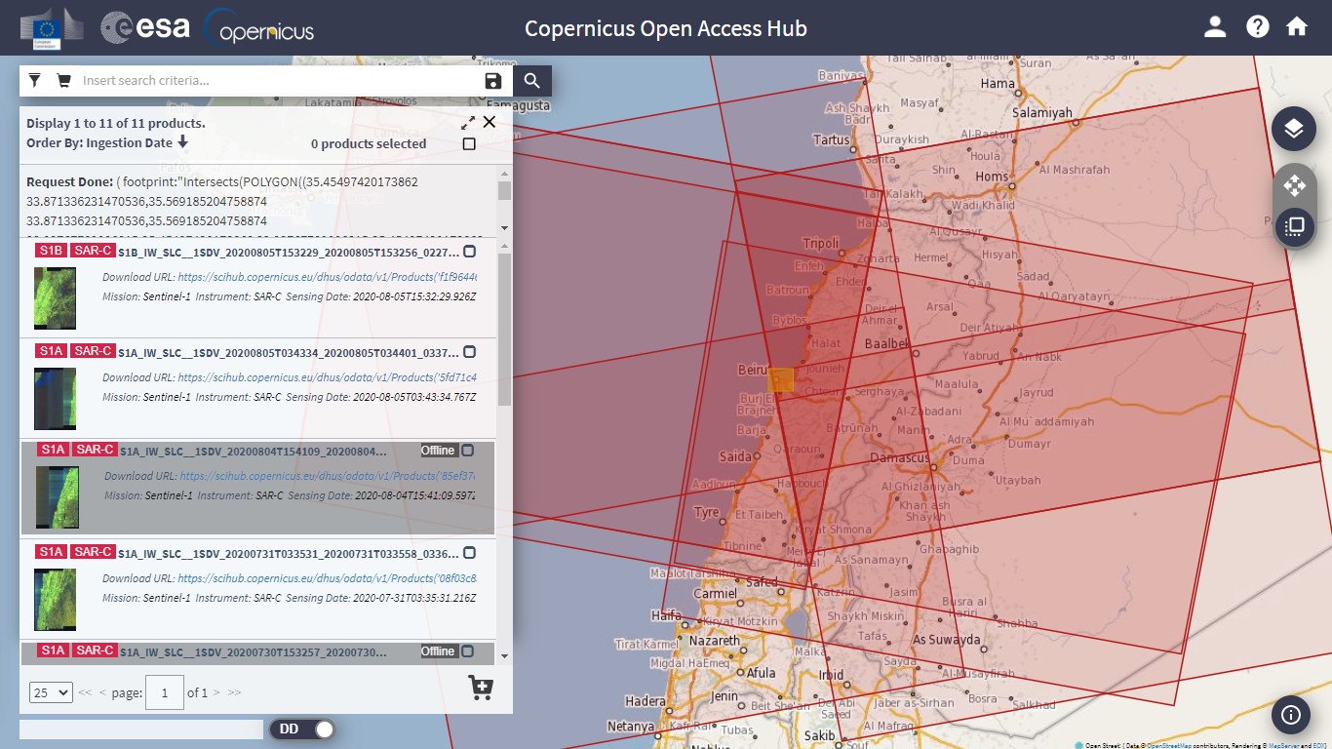
Relative Orbit selection
From Copernicus Open Data Hub
Here an example of several relative orbit footprints. One need to be selected

Slide 7
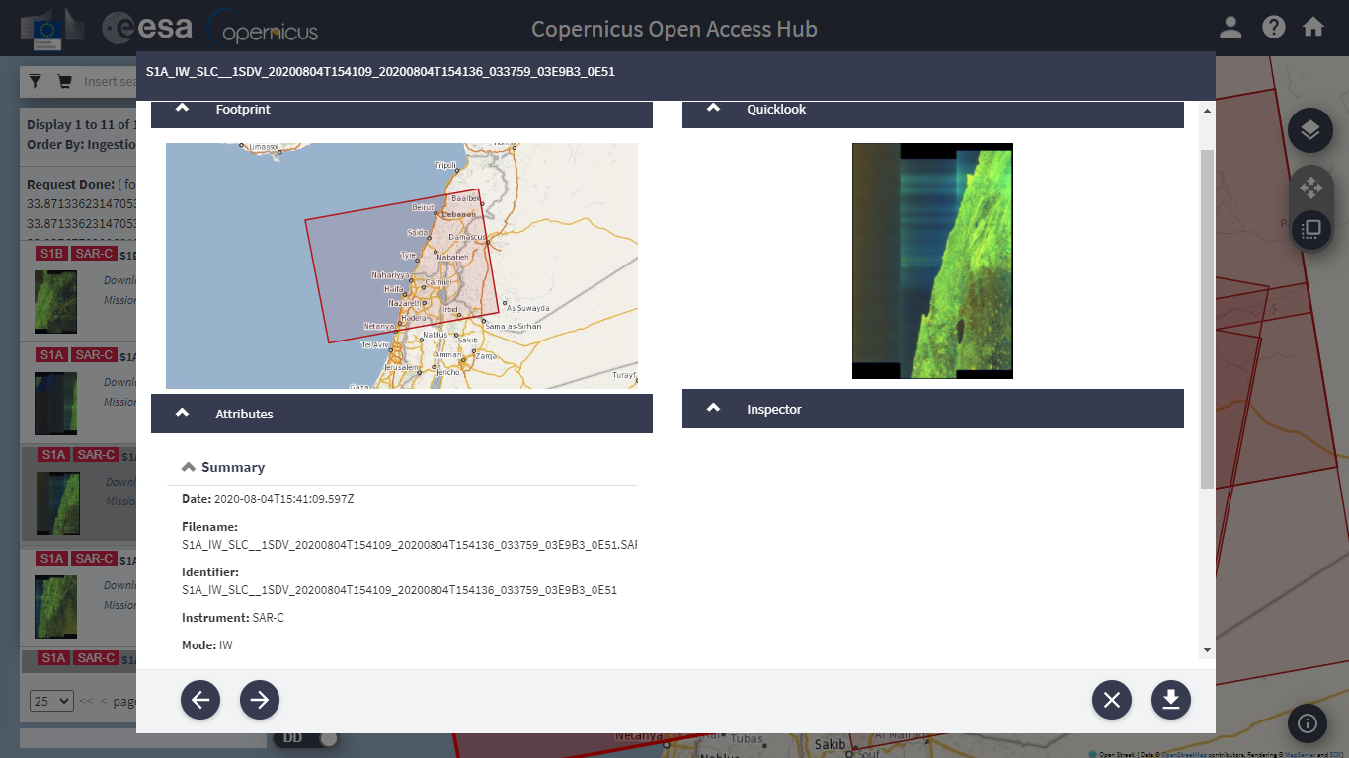
Relative Orbit selection: searching on the product metadata

Slide 8
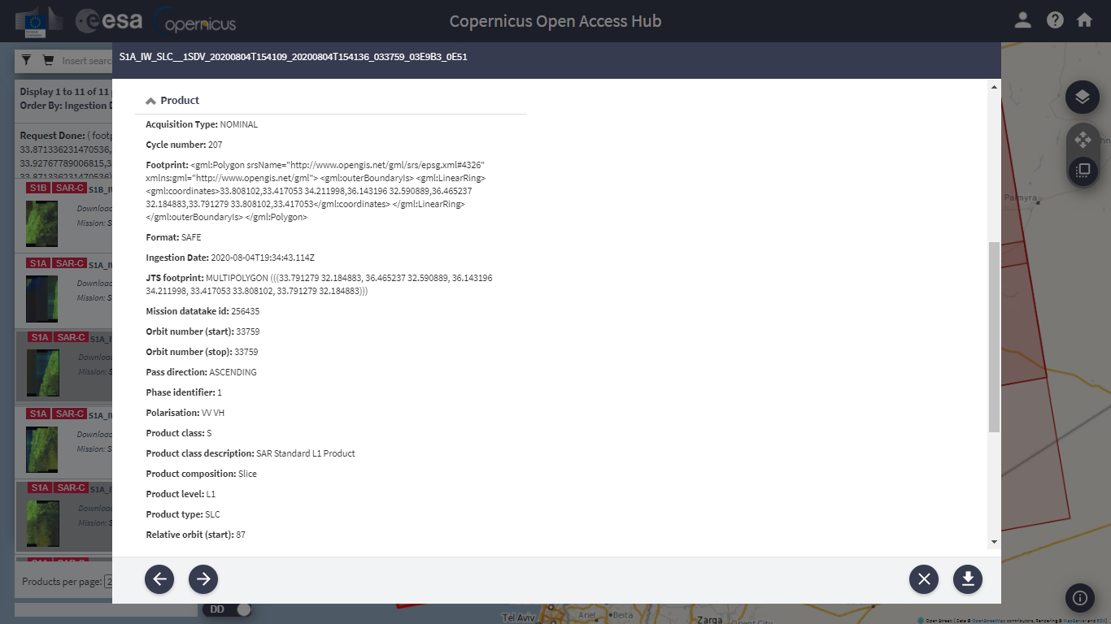
Relative Orbit selection: finding its number on the product metadata

Slide 9
Hands On Example

Slide 10
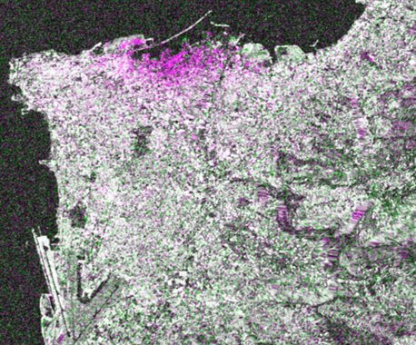
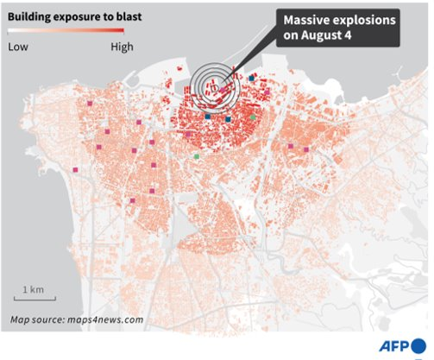
Beirut explosion on 4th August 2020 (Lebanon)
Contains modified Copernicus Sentinel-1 data [2020]

Slide 11
Beirut explosion
Coherence computation using Copernicus Sentinel-1 data:
Parameters:
Subswath: IW1
Polarisation: VV
Relative Orbit: 94
Data downloaded from Copernicus Open Data Hub
https://scihub.Copernicus.eu
S1A_IW_SLC__1SDV_20200724T034334_20200724T034401_033591_03E49D_96AA
S1B_IW_SLC__1SDV_20200730T034254_20200730T034321_022695_02B131_E8DD
S1A_IW_SLC__1SDV_20200805T034334_20200805T034401_033766_03E9F9_52F6

Slide 12
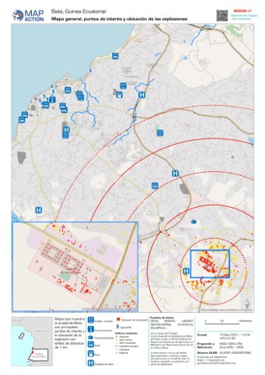
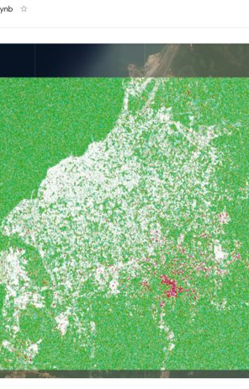
Bata explosion on 7th March 2021 (Equatorial Guinea)
https://reliefweb.int/map/equatorial-guinea/bata-guinea-ecuatorial-mapa-general-puntos-de-inter-s-y-ubicaci-n-de-las​
Contains modified Copernicus Sentinel-1 data [2021]

Slide 13
Bata explosion
Coherence computation using Copernicus Sentinel-1 data:
Parameters:
Subswath: IW1
Polarisation: VV
Relative Orbit: 132
Data downloaded from Copernicus Open Data Hub
https://scihub.Copernicus.eu
S1A_IW_SLC__1SDV_20210215T173555_20210215T173625_036604_044CDE_7E53
S1A_IW_SLC__1SDV_20210227T173555_20210227T173624_036779_0452EC_EEB1
S1A_IW_SLC__1SDV_20210311T173555_20210311T173625_036954_045905_5225

